Slide 1
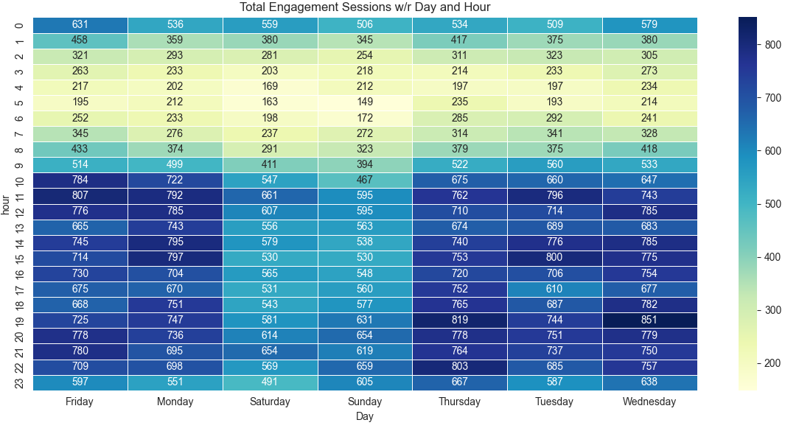
Total Engagement Session w/r Day and Hour

Slide 2
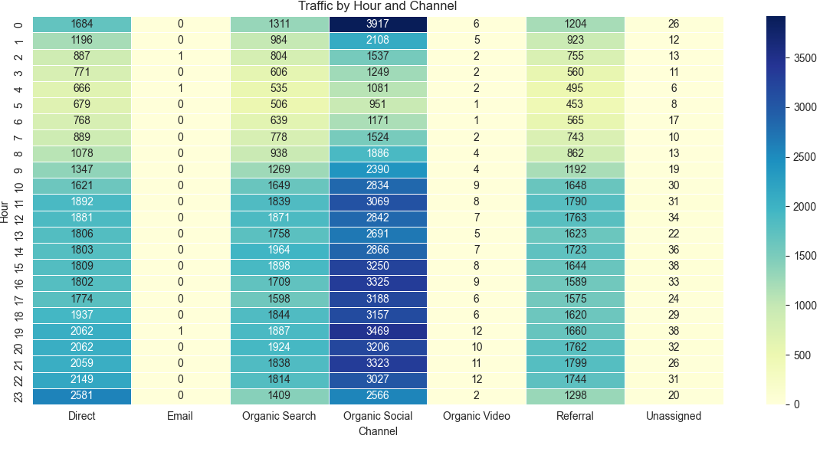
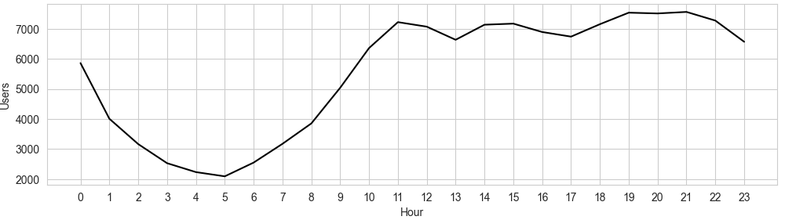
Traffic by Hour and Channel
Total Number of users by Hour

Slide 3
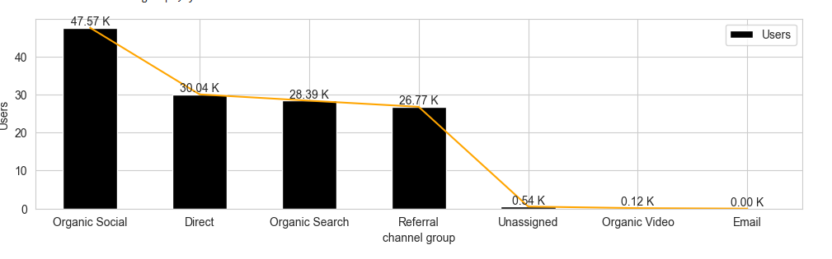
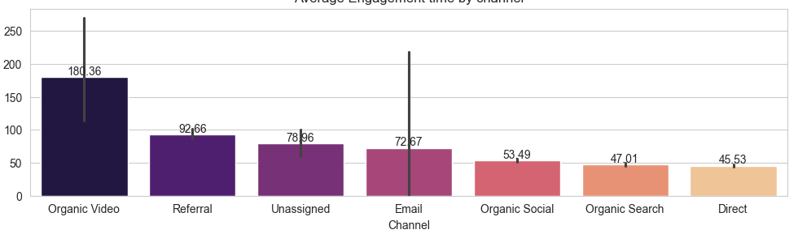
Total Users by Channel
Average Engagement Time by Channel

Slide 4
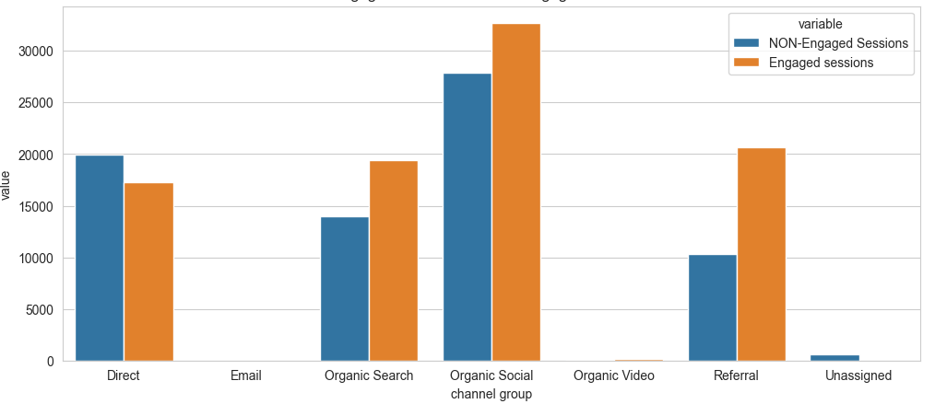
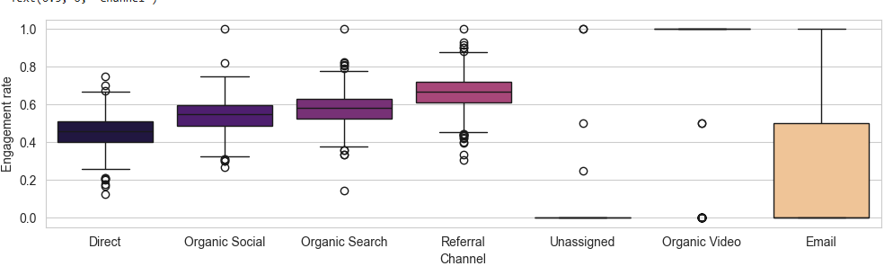
Engaged Sessions vs NON-Engaged Sessions
Engagement Rate across Different Channel Group

Slide 5
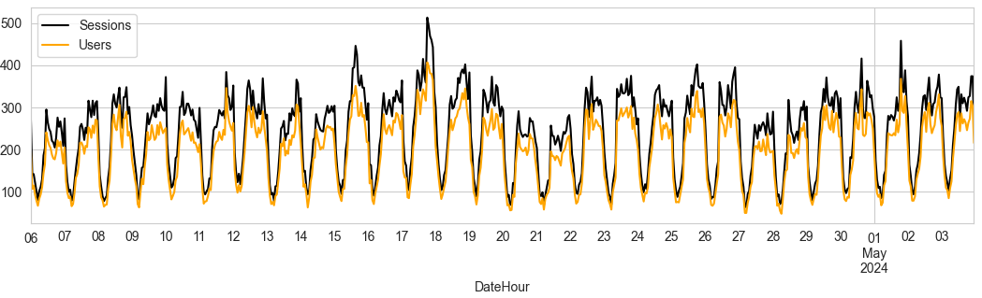
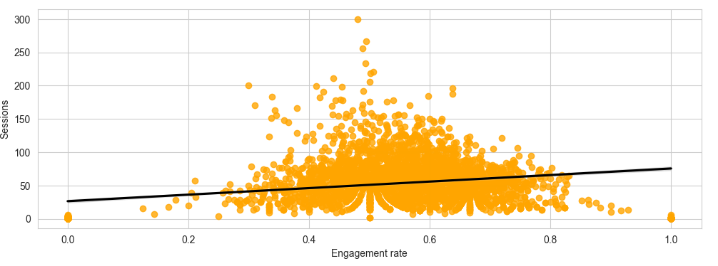
Sessions and Users Overtime
Relation between Engagement Rate and Session

